Slide 1
SQL in IBMi
DB2 Query Manager, an interactive query and report generator, allows users to define and run queries accessing DB2 for i databases.

Slide 2
CONTENTS:
Interactive SQL session screen overview.
Accessing special registers interactively.
Create/Alter/Rename/Drop tables
Simple Select/Insert/Update/Delete
ADDRDBDIRE
Group by, Order by
Is null/ Is not null
Union/union all/Except/Intersect
Scalar, Aggregate Functions
Explicitly Casting data types
IFNULL, Coalesce
Case expression
SubQueries

Slide 3
Continued..
Replace, Translate
Creating sequence
Alter/Drop sequence
System tables
UDTF
JOINS(Theta, inner, left (outer), right (outer), self, exception)
Table RRN conditional
Formatting/manipulating - Date/time/timestamp
WITH selection
Update columns based on joining another table, Merge statement
Query manager and usage of QRYDFN/SQL type objects
Retrieve Query from an object in text (SQL format)

Slide 4
Continued..
Introduction to SQLRPGLE
Setting compiler Options
Using special registers in program
Different ways of executing an SQL statement in program
Using Cursors
Types of cursor
Types of fetch from cursor
Insert multiple rows into table at once in SQLRPGLE

Slide 5
Accessing special registers interactively/programmatically.
current date/time/timestamp/timezone/client_wrkstnname/client_userid/schema/server/session_user/system_user/user
Substitutes:
current timestamp - now()
current date - curdate()
current time - curtime()

Slide 6
Create/Alter/Rename/Drop tables
Create (or replace) table testlib/tbl1 (
recseq numeric(5),
Fname character(10)) rcdfmt tbl1r
OR
Create (or replace) table testlib/tbl1 as (select fld1,fld2,…. From another_Table) with (no) data
ALTER TABLE TESTLIB/TBL1 ADD COLUMN LNAME CHARACTER (20 ) NOT NULL WITH DEFAULT
ALTER TABLE TESTLIB/TBL1 ADD CONSTRAINT UNIQUE_CNSTR_TBL1 UNIQUE (RECSEQ)
insert into testlib/tbl1 values
(1, 'First1', 'Last1'),
(2, 'First2', 'Last2'),
(3, 'First3', 'Last3’)
insert into testlib/tbl1 values
(1, 'First3', 'Last3’) // won’t work due to unique constraint
Rename table testlib/tbl1 to tbl
delete from testlib/tbl
Drop table testlib/tbl

Slide 7
Simple Select/Insert/Update/Delete
Select * from (qualified)tablename
OR
Select * from (qualified)tablename FETCH FIRST n ROWS only
Insert into (qualified)tablename values(val1, val2,val3,…)
OR
Insert into (qualified)tableName (select val1,val2,.. From another_Table)
Update tableName set fld1 = <…> (where condition…)
Delete from tableName (where condition…)

Slide 8
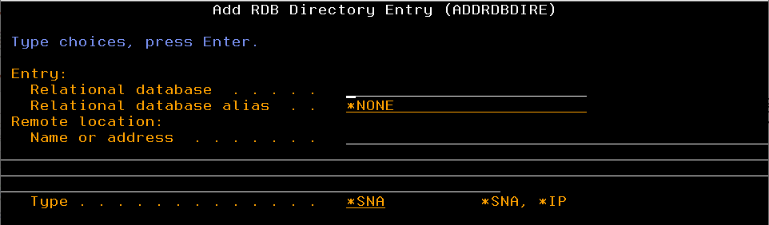
ADDRDBDIRE
It is the configuration option where we can add another logical partition to access data using CRTDDMF or using sql statement with qualified tableName using partitionName
Ex: Let marketing be the second partition name.
And you need to access the data from that partition’s table customer in library prod1
Query: Select * from marketing.prod1.customer

Slide 9
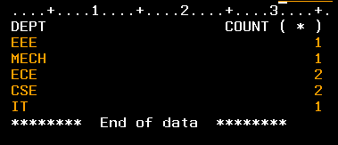
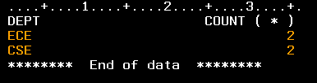
Group by, Order by
Group by : to get output of a collection of similar identified column values with an aggregate function
Ex: select dept, count(*) from sensp group by dept
Here, count(*) is aggregate function.
Having: used with GROUP BY to include conditions upon the aggregate function’s value.
Ex: select dept, count(*) from sensp group by dept having count(*) > 1
Order by: to order the sequence of result set on the basis of fields mentioned as asc or desc. (Bydefault is Asc)

Slide 10
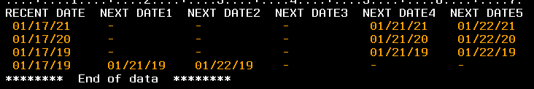

Is null/ Is not null
Conditional clauses.
Ex: DATEP table has the below shown values.
To fetch the rows having valid NEXT DATE1 values, query used:
Select * from DATEP where NXTDT1 is not null
To fetch rows having null stored in NEXT DATE1 field, query used:
Select * from DATEP where NXTDT1 is null

Slide 11
Union/union all/Except/Intersect
Union: returns distinct data set of two select queries of similar structure.
Union all: returns data set of two select queries of similar structure.
Except: returns non matching data set of two select queries of similar structure.
Intersect: returns matching data set of two select queries of similar structure.

Slide 12
Scalar, Aggregate Functions
Scalar Function: operates against single value and returns single value.
Ex: upper(), lower(), trim(), length(), etc.
Aggregate Functions: operates against set of rows in a column and returns single value.
Ex: max(), min(), Sum(), avg(), count(), etc..

Slide 13
Explicitly Casting data types
A value stored as a particular data type can be converted to another data type by using functions.
Ex: char(), decimal(), int(), date(), timestamp_format(), CAST(),etc..
Sample query:
select char(PHONE) from sensp
select cast(phone as char(10) ccsid 37) from sensp
select char(COLUMN_HEADING), char(COLUMN_TEXT) FROM qsys2.syscolumns

Slide 14
IFNULL, Coalesce
IFNULL: function is used in selection of fields. It can have only two arguments. Implies, if value in first argument is null, then return second argument’s value. The data type of both arguments should be same
Ex: select curdt, ifnull(nxtdt1,current date + 10 years)
from datep
COALESCE: same as IFNULL but number of arguments is upto the user. Minimum 2 arguments.
Ex: select curdt, coalesce(nxtdt1,nxtdt2,nxtdt3,current date + 10 years)
from datep

Slide 15
Case expression
It goes through conditions and returns a value when the first condition is met (like an IF-THEN-ELSE statement). So, once a condition is true, it will stop reading and return the result. If no conditions are true, it returns the value in the ELSE clause.
Syntax: case when <condition1> then <result1>
when <condition2> then <result2>
..
other <generic result> End
Ex: select studentName, case when mark >90 then ‘A’
when mark between 71 and 90 then ‘B’
when mark between 51 and 70 then ‘C’
other ‘F’ end as Grade
from testReport

Slide 16
Sub-Queries
It is a select query inside another select query, where the former acts as source data set for the latter.
Ex: select * from ( select * from testReport where status = ‘Active’) a
where a.mark > 50
Exists/ not Exists condition:
we can retrieve only selected rows from a table or data set which exists(or not exists) in the returned data set of a sub query.
Ex: select * from unionp where exists (select * from exceptp where sts =‘A’)
Select * from unionp a where exists (select * from exceptp b where a.id = b.id)

Slide 17
Replace/Translate
REPLACE: Replaces all occurrences of a specified string value with another string value at once. Works with numeric as well as string expression.
Syntax: REPLACE(expression, from-set, to-set)
Ex: values REPLACE('123', '123', '456’) //Result = 456
values REPLACE('123', ‘321', '456’) //Result = 123
values REPLACE('123321', '321', '456’) //Result = 123456
TRANSLATE: Returns the string provided as a first argument after some characters specified in the second argument are translated into a destination set of characters.
Works with numeric as well as string expression.
It replaces each character one by one, regardless of the order of those characters.
Syntax: TRANSLATE(expression , to-expression, from-expression, pad)
Ex: values TRANSLATE('123', '456’, '123') //Result = 456
values TRANSLATE('123', '456’, ‘321') //Result = 654
values TRANSLATE('123321', '45', '123', '-’) //Result = 45--54

Slide 18
Creating Sequence
Sequences are created at the application server. Created as DataArea. Each time you access the value of sequence using ‘next value for seq_name’, the value increments.
Ex: CREATE SEQUENCE lib/Seq_name
START WITH 1
INCREMENT BY 1
NO MAXVALUE //maxvalue 9999
NO CYCLE //to repeat from starting number when max value is reached
CACHE 24 // 20 is default (not mandatory to specify)
Usage Example:
Create (or replace) table testlib/tbl1 (
recseq numeric(5),
Fname character(10)) rcdfmt tbl1r
insert into testlib/tbl1 values
(next value for rec_seq, 'First1', 'Last1'),
(next value for rec_seq, 'First2', 'Last2'),
(previous value for rec_seq, 'First3', 'Last3’)

Slide 19
Alter/Drop sequence
Sequences can be altered like tables.
The ALTER SEQUENCE statement can be used to change a sequence in any of these ways:
Restarting the sequence
Changing the increment between future sequence values
Setting or eliminating the minimum or maximum values
Changing the number of cached sequence numbers
Changing the attribute that determines whether the sequence can cycle or not
Changing whether sequence numbers must be generated in order of request

Slide 20
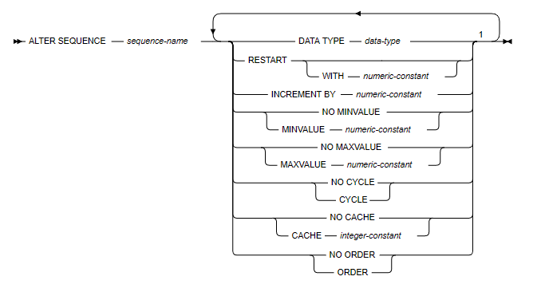
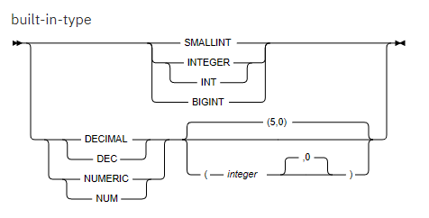

Continued…

Slide 21
System tables
Sytem tables/Views exist in the product libraries (QSYS/QSYS2/QUSRSYS/..)
Mostly the views in QSYS2 are usable to retrieve information.
Popular ones - ASP_INFO, FUNCTION_USAGE, JOB_QUEUE_INFO, JOB_DESCRIPTION_INFO, JOURNAL_INFO, OBJECT_LOCK_INFO, RECORD_LOCK_INFO, SYSTABLES, SYSCOLUMNS, SYSTRIGGERS, etc.
These views come with specific PTFs(Product Temporary Fix) to be installed in OS.

Slide 22
UDTF (User Defined Table Functions)
Like System tables, there are functions which also comes handy to retrieve specific information from system. These are also PTF specific.
Ex: JOBLOG_INFO()
Sample Query:
select * from table(qsys2.joblog_info('032842/ADARSH/QPADEV0001’))

Slide 23
JOINs (Theta Join)
It allows user to return data from all the tables being joined on user specific conditions.
Theta join:
Here, two or more tables can be listed in query with ‘ , ’ in between and the joining condition is listed under WHERE condition.
Ex: select * from unionp a, exceptp b, intersectp c
where a.name = b.name and a.name = c.name
All columns from all the tables will be retrieved here with data matching the specified condition.

Slide 24
JOIN (Inner Join)
It allows user to return data from all the tables being joined on user specific conditions.
Works same as theta join.
JOIN keyword is used and the joining condition is mentioned after ON keyword
Multiple tables can be joined over a sequence of JOIN and ON keywords.
Sample Query:
select a.* from unionp a join exceptp b on a.name = b.name and a.dept = b.dept

Slide 25
JOIN(Left/Left outer Join)
It allows user to return data from the table specified on left side of JOIN keyword being joined on user specific conditions long with the matching data from right side of the JOIN keyword over specified condition.
For the unmatched data from the table specified on right side of JOIN keyword, it shows as NULL
Multiple tables can be joined over a sequence of LEFT(OUTER) JOIN and ON keywords.
Ex: select * from unionp a left outer
join exceptp b on a.name = b.name and
a.dept = b.dept

Slide 26
JOIN(Right/Right Outer Join)
It allows user to return data from the table specified on right side of JOIN keyword being joined on user specific conditions long with the matching data from left side of the JOIN keyword over specified condition.
For the unmatched data from the table specified on left side of JOIN keyword, it shows as NULL
Multiple tables can be joined over a sequence of RIGHT(OUTER) JOIN and ON keywords.
Ex: select * from unionp a right outer
join exceptp b on a.name = b.name and
a.dept = b.dept

Slide 27
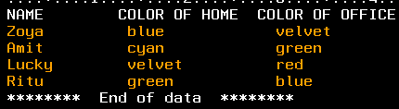
JOIN (Self Join)
It is same as JOIN functionality where a table is joined with itself over a joining condition.
Useful when two or more columns can have same values and to find a match among records based on two different columns
Ex:
Q: To find name of person whose office color matches with Zoya’s home color.
select * from selfp a, selfp b where a.homeclr = b.officeclr and
a.name = 'Zoya'

Slide 28
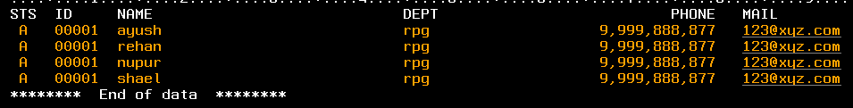
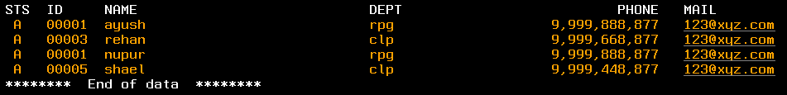
JOIN(Exception Join)
It returns result set from first file, joining two or more files when unmatched on values of column specified over joining condition.
Data set of file UNIONP:
Data set of file EXCEPTP:
When exception join is executed over UNIONP and EXCEPTP, the unmatched data of columns specified in JOINING condition is excluded from the result set and data from first file is returned with column values of second file as NULL
select * from unionp a exception join exceptp b
on a.id = b.id and a.name = b.name
.

Slide 29
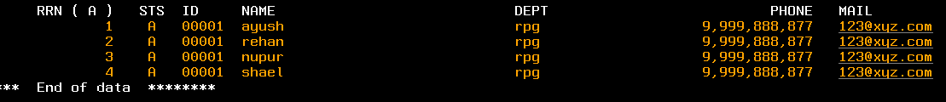
Table RRN
Every database file or table has a RRN attached to a record which sequentially increases with insertion of new data set into file/Table.
Use alias for table and the function RRN(alias) to see RRN value in a new column.
Ex:
Select rrn(a), a.* from unionp a
Major usage: To find the recent records based on RRN where column values can be duplicates.

Slide 30
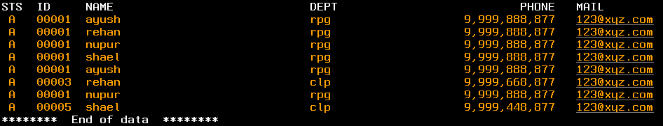
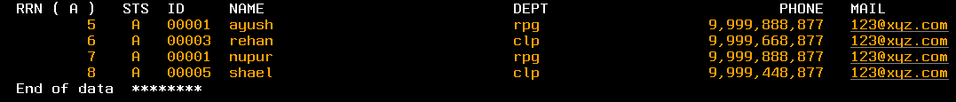
Table RRN(continued..)
Ex: There exists a table DUPL with data as shown below.
To select the records with unique names which have been recently inserted, use query:
select rrn(a), a.* from dupl a where rrn(a) =
(select max(rrn(b)) from dupl b where a.name = b.name)
.

Slide 31
Formatting/Manipulating Data, Time, Timestamp
To manipulate a Time, directly add or subtract minute/hour/second as per requirement.
<Time column> -/+ n HOUR
<Time column> -/+ n MINUTE
<Time column> -/+ n SECOND
You can not directly do a substring on Time format value, explicit conversion is required.
To Manipulate a Date, directly add or subtract month/day/year as per requirement.
<Date Column> -/+ n DAY
<Date Column> -/+ n MONTH
<Date Column> -/+ n YEAR

Slide 32
Continued..
Extracting part of Time from time column:
MINUTE(time column)
HOUR(time column)
SECOND(time column)
Extracting part of Date from date column:
MONTH(date column)
DAY (date column) OR DAYOFMONTH(date column)
YEAR(date column)
Extracting additional information from a date:
DAYOFWEEK(date column) OR DAYOFWEEK_ISO(date column) – Returns numbered day of week between 1 and 7.
DAYOFYEAR (date column) – Returns Julian Day
DAYNAME (date column) – Returns Name of the day. Ex: Wednesday
WEEK(date column) - Returns week number of the year. Ex: 4
MONTHNAME(date column) – Returns Name of the Month. Ex: January
LAST_DAY (date column) – Returns last date of the month for a Date value in MM/DD/YY
NOTE: All the Above can be extracted from a Timestamp as well.

Slide 33




Continued..
Timestamps:
Any date stored as numeric column in file can be converted into date type by converting it first into a character type, then into TIMESTAMP format then into DATE from its result.
Sample: The below query is a sample of a date stored as numeric in MMDDYY format.
select dt from (values 281021) as val(dt)
To get a Date value out of it, as per process, first convert it into character:
select char(dt) from (values 281021) as val(dt)
Then convert into timestamp format:
select timestamp_format(char(dt), 'ddmmyy')
from (values 281021) as val(dt)
Then convert it into a Date:
select date(timestamp_format(char(dt), 'ddmmyy'))
from (values 281021) as val(dt)

Slide 34
WITH selection
It is an extension to sub-queries. Multiple subqueries can be listed as an entity, and the entities can be used in subsequent entities or final SELECT query.
Syntax:
WITH alias1 AS ( select query….. with or without join),
alias2 AS ( select query….. with or without join),
..
..
aliasN AS ( select query…. with or without join)
Select * from <Any Alias OR join of multiple Aliases>
Example:
With t1 as (select * from class),
t2 as (select * from master where dept = ‘IT’),
t3 as (select * from t1 join t2 on t1.masterName = t2.Name)
Select * from staffroom a, t3 where a.teacherName = t3.Name

Slide 35
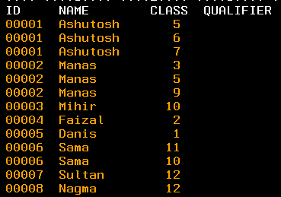

Update columns based on joining another table, Merge statement
For updating columns based on joining another table WHERE EXISTS is used on an Update statement.
Example:
Two tables, MASTERP and STUDENTP, exists.
Data set of Masterp:
Data Set of Classp:
To update qualifier field in MASTERP as ‘Class’ for the matching Names with class# in CLASSP file:
Update MASTERP a set a.qualifier = ‘Class’
Where exists (select 1 from CLASSP b where a.name = b.clteacher and a.class = b.class)

Slide 36
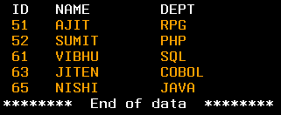
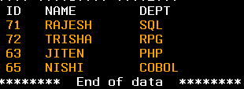
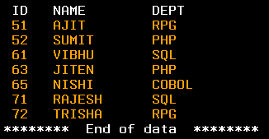
MERGE statement
It is used to insert a row if not already exists based on matching column values; and update columns , if row exists with matching column values
Consider table HISTORY with data as:
Consider table NEWDTA with Data as:
Objective: To Add the new entries from NEWDTA into HISTORY file, and update the DEPT of existing history records from NEWDTA for matching ID and Name.
Query: MERGE INTO history a USING newdta b
ON a.id = b.id and a.name = b.name
WHEN NOT MATCHED THEN
INSERT VALUES (b.id, b.name, b.dept)
WHEN MATCHED THEN
UPDATE SET a.dept = b.dept

Slide 37
Query Manager, usage of QRYDFN/SQL type objects
Query manager can be accessed by command STRQM

Slide 38
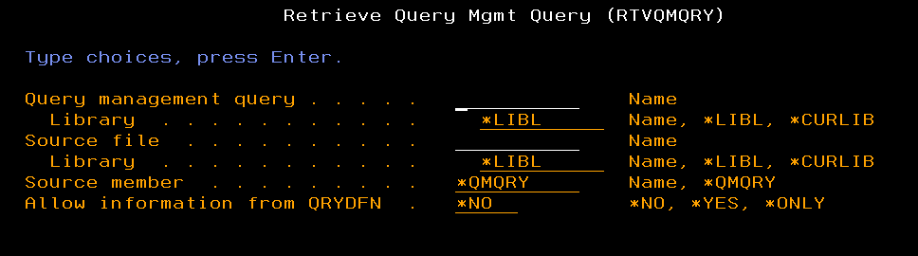
Retrieve Query from an object- (SQL format)
Steps:
Create a member inside a source physical file.
Use Command RTVQMQRY and take F4. The below screen will appear
Provide the Query management Query Name, its library, The Sourcefile name, member and its library where you want the SQL format of the story to get populated . Hit Enter.

